Slide 1

Face Recognition Attendance System
Minor Project
Project:
Department of Computer Science & Engineering

Slide 2

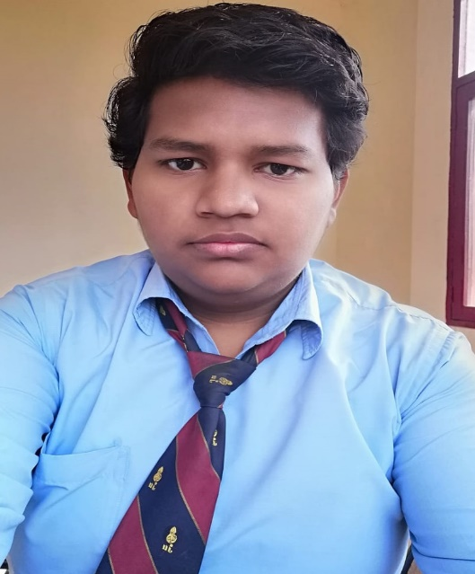
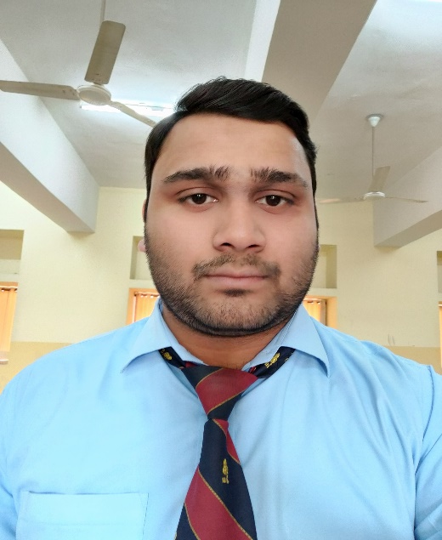
Submitted by:-
Abhinav Joshi
(8817103002)
Sajal Bansal
(8817103036)
Vipul Kumar Goyal
(8817103034)

Slide 3

Guided by:-
Er. Lalit Mohan Gupta

Slide 4
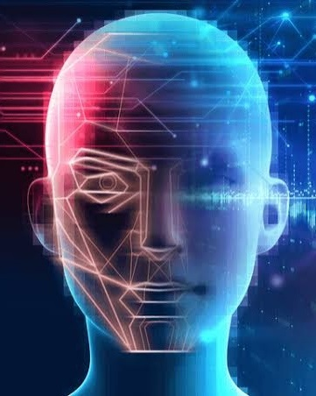
Presentation Outline
Definition
Objectives
Project Status
Methodology
Data Flow Diagram
Use Case Diagram
Database Overview
System Architecture
Algorithms
Application Snapshots
Academic Objectives
Development Tools
Conclusion
Reference
Q & A

Slide 5
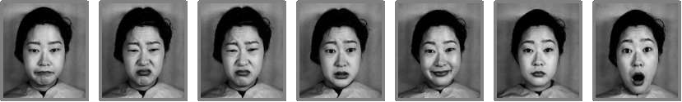
Definition
Face Recognition is a biometric method of identifying an individual by comparing live capture or digital image data with the stored record for that person.
Face Recognition Attendance System is marking of attendance based on this technology.

Slide 6
Objectives
Use live face recognition to recognize each individual and mark their attendance automatically.
Provides an automated attendance system that is practical, reliable and eliminate disturbance and time loss of traditional attendance systems.
Present a system that can accurately evaluate employee performance depending on their recorded attendance rate.
Notification via email when we departure or arrival in organization.

Slide 7
Project Status: Completed

Slide 8
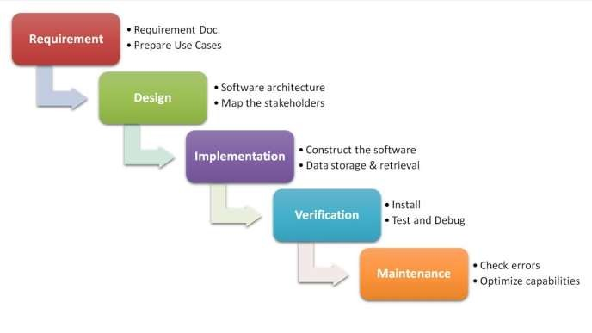
Methodology
Waterfall Model is a sequential approach, where each fundamental activity of a process.
Represented as a separate phase, arranged in linear order.
In the waterfall model, you must plan and schedule all of the activities before starting, working on them (plan-driven process).

Slide 9
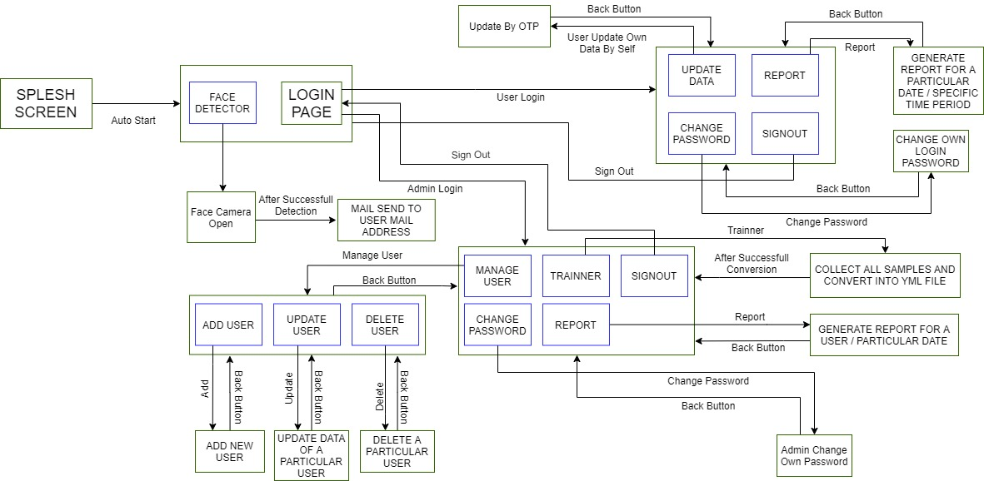
Data Flow Diagram

Slide 10
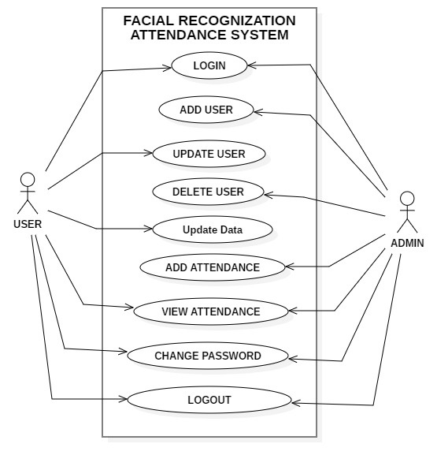
Use Case Diagram

Slide 11
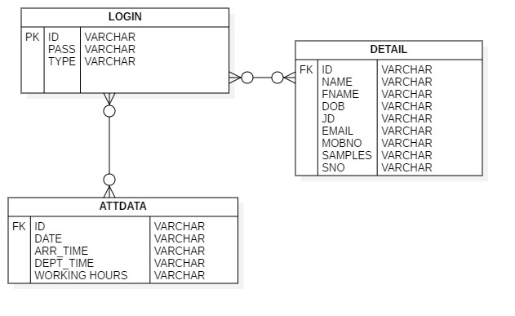
Database Overview

Slide 12
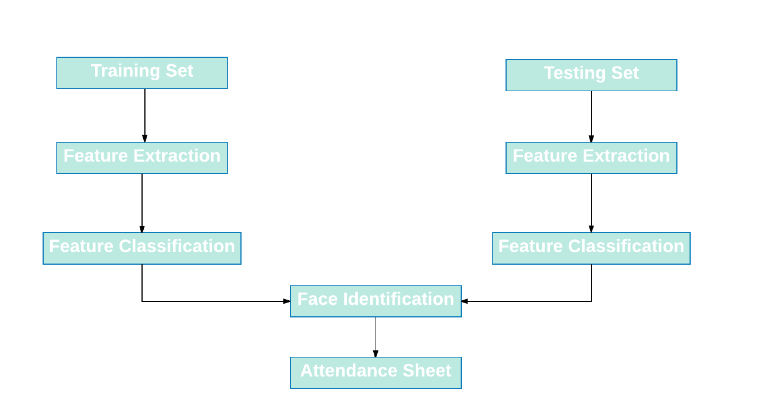
System Architecture

Slide 13
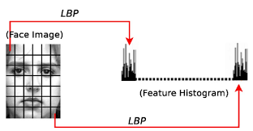
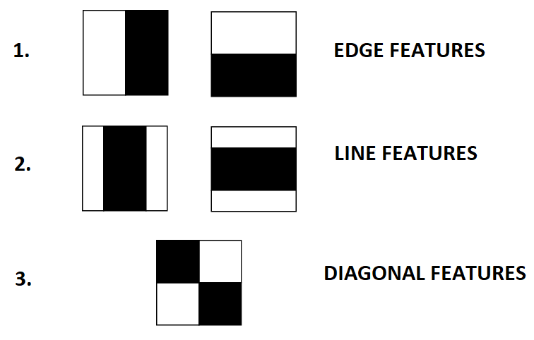
Algorithms
Local Binary Pattern Histogram (LBPH)
Viola Jones Algorithm

Slide 14
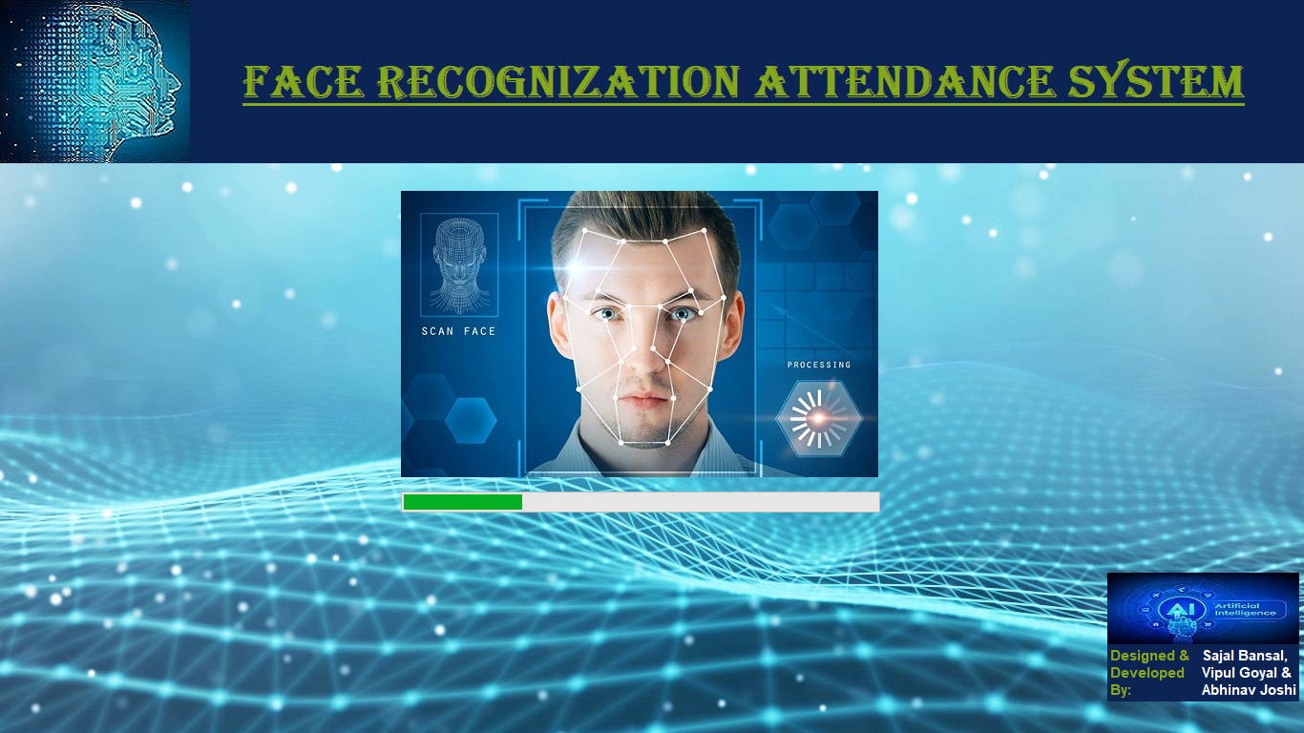
Application Snapshot-1

Slide 15
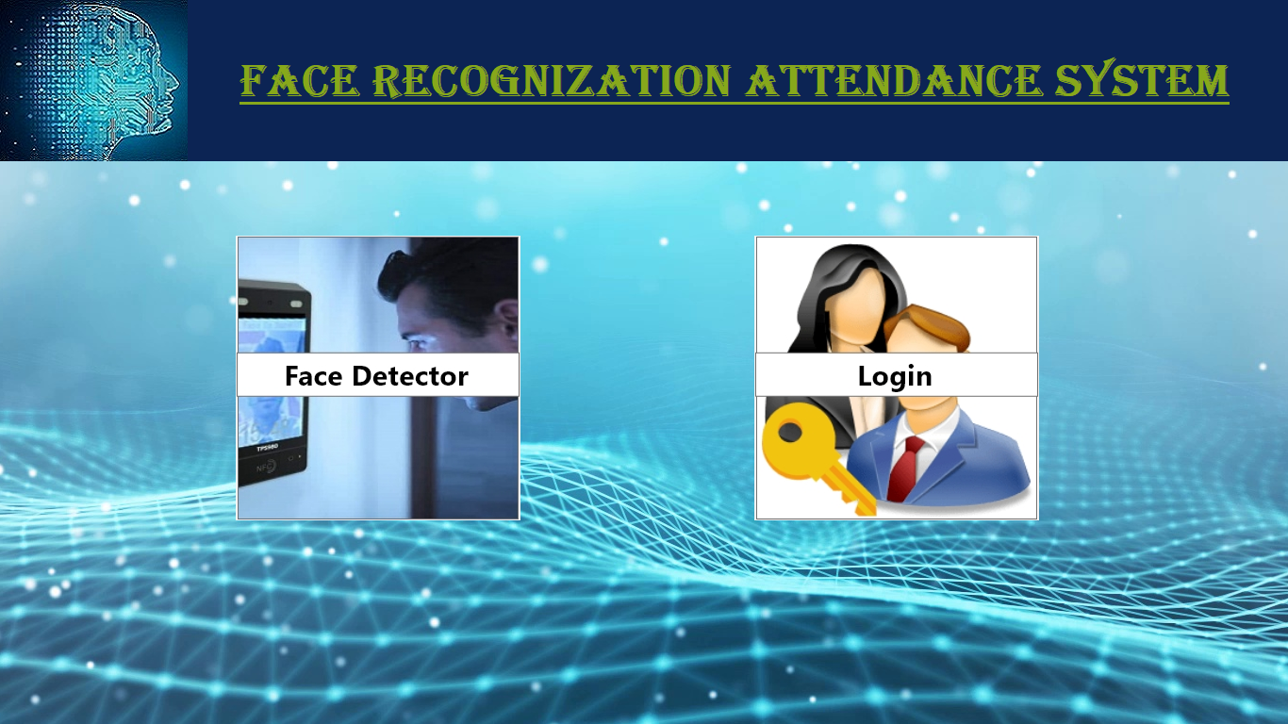
Application Snapshot-2

Slide 16
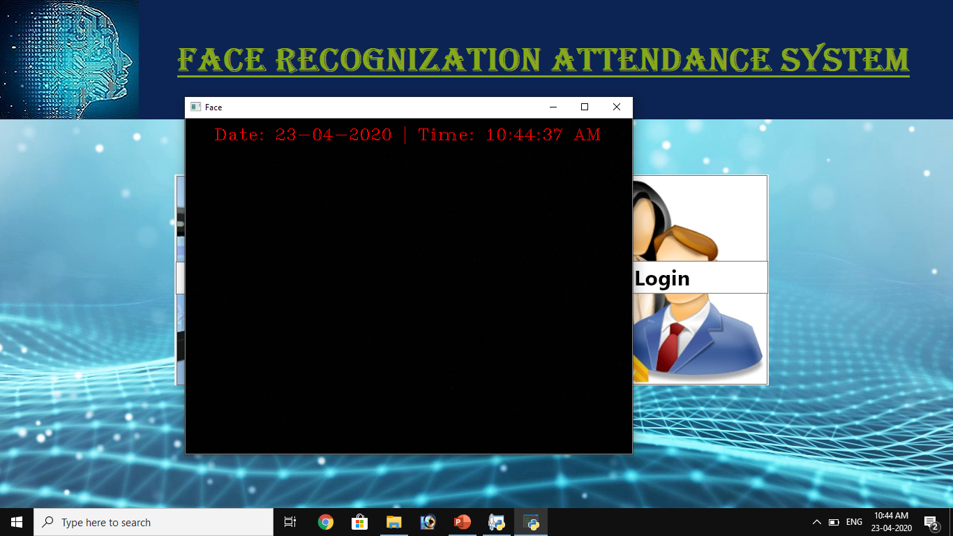
Application Snapshot-3

Slide 17
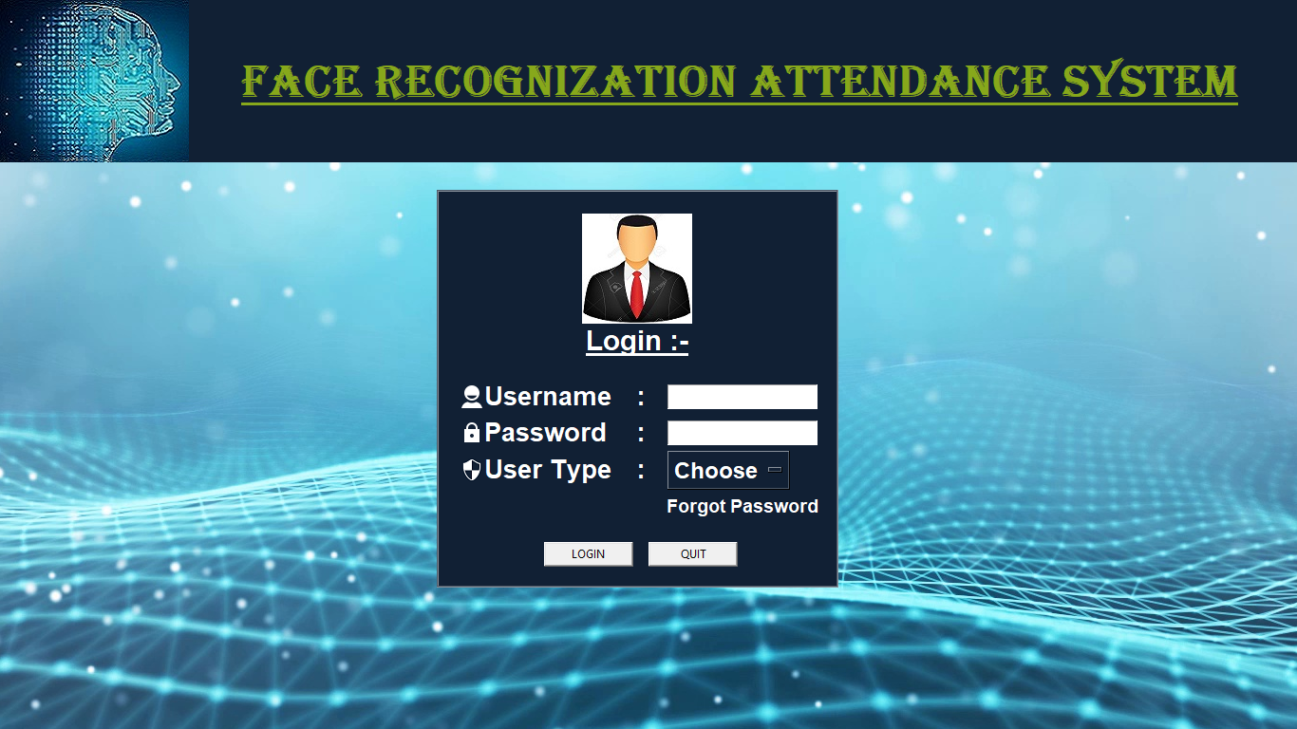
Application Snapshot-4

Slide 18
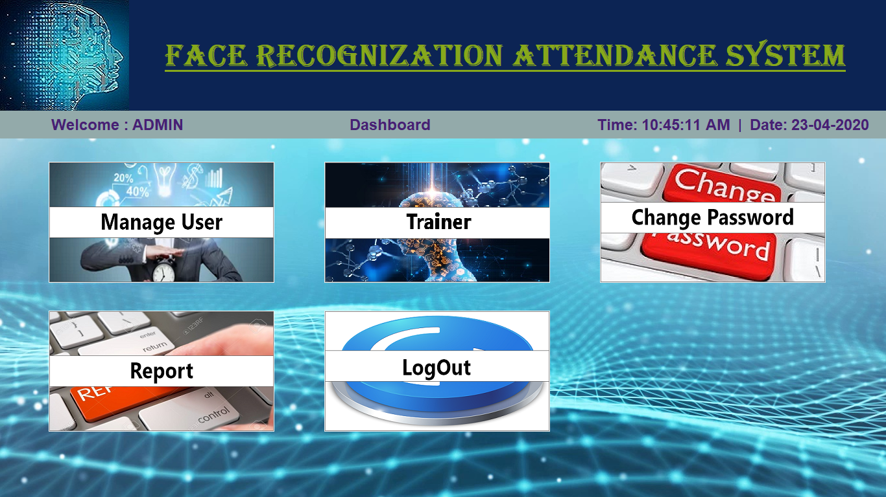
Application Snapshot-5

Slide 19
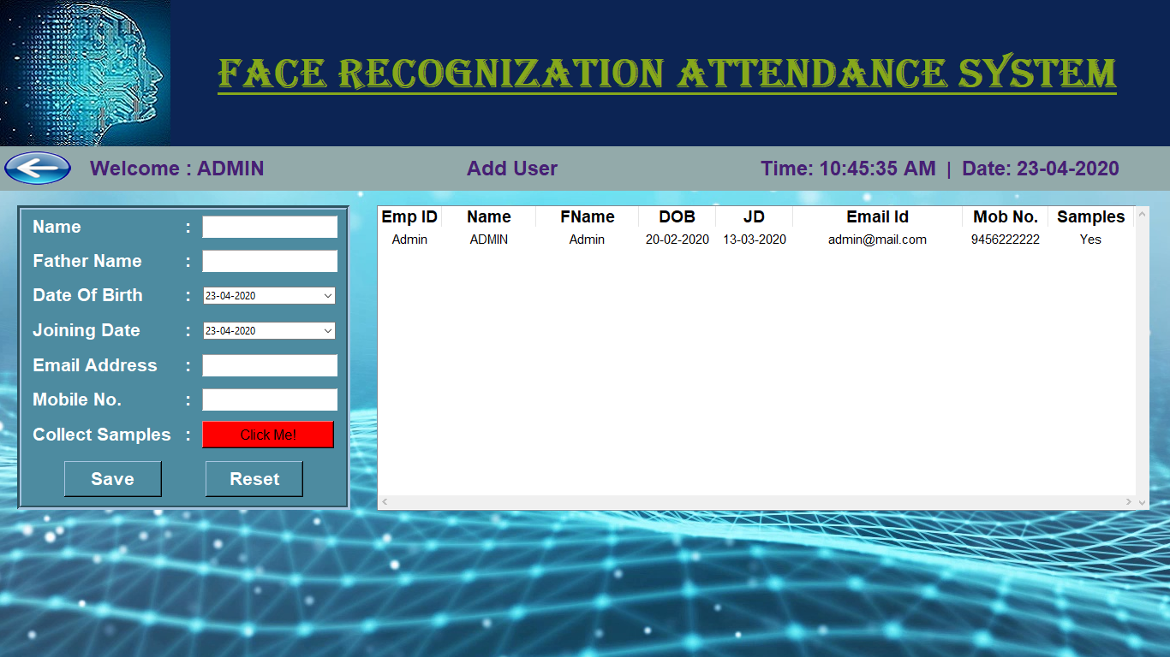
Application Snapshot-6

Slide 20
Academic Objectives
From scratch to working software, carrying out real-world software projects in our academic studies helps us to understand what we have to face in industry.
We have learned most of the industrial strategies used for completion of project by keeping accounts of time, quality, and budget.
This project was a door to a Stairs of Success towards the bright Software Engineering career.

Slide 21

Development Tools
Adobe XD
SQLite
PyCharm

Slide 22
Conclusion
The project exposed us to the latest technology in the universities and offices. This project successfully demonstrated as biometric method that will be of great use to the office employees.
For implementations where the biometric system must verify and identify users reliably over time, facial scan can be a difficult task, but not impossible.
We acknowledge with great thanks to our supervisor “Er. Lalit Mohan Gupta” for his most valuable suggestion and co-operation.

Slide 23
Reference
https://www.google.com/search?q=face+recognition&oq=facerec&aqs=chrome.2.69i57j0l7.4796j0j7&sourceid=chrome&ie=UTF-8
https://stackoverflow.com/questions/tagged/opencv
https://docs.opencv.org/2.4/modules/contrib/doc/facerec/facerec_tutorial.html
https://www.youtube.com/watch?v=h21wMKGs0qs

Slide 24
Thank You!

